Slide 1


P437: Predicting Term Deposit Subscriptions
(Domain - Banking)
This presentation outlines a comprehensive Exploratory Data Analysis (EDA) of a bank marketing dataset. The goal is to develop a predictive model that can classify whether a customer will subscribe to a term deposit based on various factors.
1

Slide 2

Team Collaboration: Group Members for Project Success
Meet our dedicated team members:
Stephy John
Mandula Harika
Maddula Venkateswara Reddy
Amandeep Annasaheb Parandkar
Atla Sai Rajesh Reddy
Channabasava
2

Slide 3
Contents
Project Overview
Methods for Improvement
Objective and Dataset Overview
Dimensionality Reduction
Data Overview and Initial Processing
Feature Engineering and Outlier Treatment
Data Loading and Structure
EDA Insights
Memory Optimization and Typecasting
Model Building and Evaluation
Key Statistical Insights
Hyperparameter tuning
Summary Statistics and Outliers
Evaluation
Numeric Feature Distributions
Metrics Graphs
Data Visualization & Correlation Analysis
Interpretation
Target Distribution
Top 10 features.
Correlation Matrix and Insights
Deployment
Issues ,,Challenges and Feature Engineering
Conclusion
Feature Creation and Transformations
Project Outcome and Impact
Handling Multicollinearity
3

Slide 4

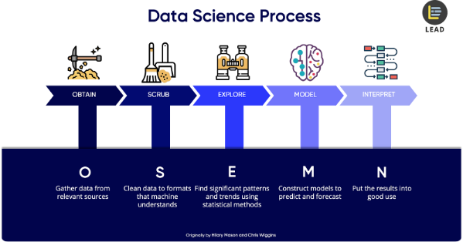
Project Overview
Objective
Dataset
Develop a predictive model to classify whether a customer will subscribe to a term deposit based on demographic, socio-economic, and campaign-related factors.
The dataset consists of 41,118 customers with 21 features, including age, job, marital status, education, duration of last contact, and more. The target variable is binary (yes/no) indicating whether the customer subscribed to a term deposit.
4

Slide 5

Project Goals & Progress
1
Data Collection
Completed.
2
EDA
Completed.
3
Data Preprocessing
Completed.
4
Feature Engineering
Completed.
5
Model Building
Completed.
5
5

Slide 6
Project Goals & Progress
6
Model Evaluation
Completed.
7
Hyper parameter Tuning
Completed.
8
Model Interpretation
Completed.
9
Deployment
Completed.
10
Final Submission & ppt
Completed.
6
6

Slide 7
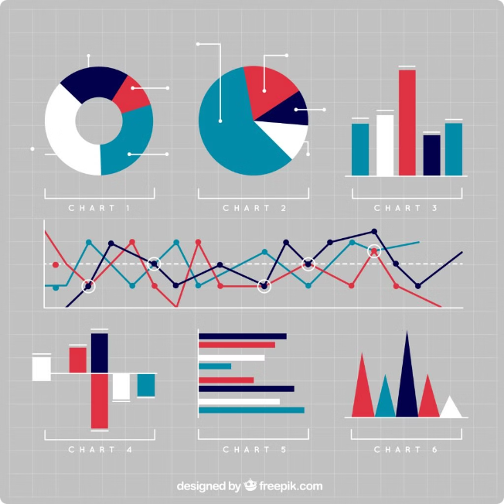
Exploratory
Data Analysis
7

Slide 8

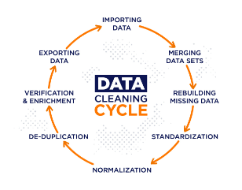
Data Overview and Initial Processing
Memory & Libraries
Dataset Structure
Key libraries such as Pandas, NumPy, Seaborn, Matplotlib, Scikit-learn ,model selection, evaluation metrics and reporting libraries were imported to ensure efficient memory usage and data manipulation.
The dataset contained no missing values. There were high cardinality features like job, marital status, and education categories, requiring appropriate handling during analysis.
1
2
3
Data Inspection
Data structure and initial rows were reviewed, and data types were checked. Categorical variables were converted to appropriate types for optimized performance.
8

Slide 9

Key Statistical Insights
1
Age
The mean age of customers is 40.02 years, with a median of 38 years. The age range spanned from 18 to 95 years.
2
Duration
The duration of the last contact was highly skewed, requiring a log transformation to normalize the distribution.
3
Outliers
Outliers were detected in features like campaign and pdays, and they were handled through capping and imputing techniques to mitigate their impact on analysis.
4
Key Numeric Feature Distributions
Most customers contacted were between the ages of 30-40, and the average duration of the last contact significantly impacted conversion rates.
9

Slide 10
Data Visualization and Correlation Analysis
Target Distribution
Correlation Insights
The target variable was highly imbalanced, with approximately 88% of customers not subscribing and 12% subscribing to a term deposit. A count plot effectively visualized this distribution.
Strong correlations were observed between duration, nr\_employed, and euribor3m with the target variable. Most demographic features showed weak correlations. A correlation heatmap was generated to visualize relationships between numeric variables.
10

Slide 11

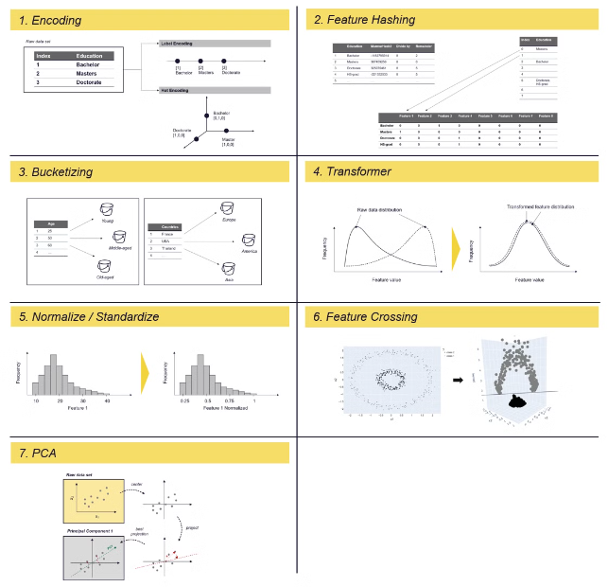


Issues and Challenges
Imbalanced Dataset
The dataset is imbalanced, with more clients not subscribing to a term deposit than those who do. Imbalanced datasets can affect model performance . SMOTE (Synthetic Minority Over-sampling Technique) is used to balance the dataset .
Multicollinearity
Multicollinearity was detected between emp\_var\_rate and euribor3m, which can affect model performance. Techniques like Variance Inflation Factor (VIF) analysis or Principal Component Analysis (PCA) were planned to address this issue.
11

Slide 12
Feature Engineering
Feature Engineering
New features were created. Interaction terms between employment rate and balance were also considered.
12

Slide 13

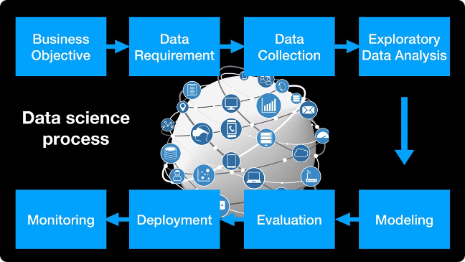
Methods for Improvement
Methods
Details
Dimensionality Reduction
PCA applied to reduce feature space and address multicollinearity.
Advanced Feature Engineering
Temporal features (month/day of week), interaction terms, and polynomial features can capture non-linear relationships and potentially improve model accuracy.
13

Slide 14

EDA Insights
1
Important Numerical Variables
Duration, pdays, campaign, emp_var_rate, and euribor3m are likely to be important in predicting the target.
2
Influential Categorical Variables
Previous, poutcome, contact, and education seem to have influence on the target variable. Poutcome and previous may be particularly important.
3
Key Bivariate Combinations
Categorical-Categorical: previous and poutcome, contact and poutcome Numerical-Numerical: emp_var_rate and euribor3m, duration and campaign Categorical-Numerical: education and duration, contact and pdays
14

Slide 15
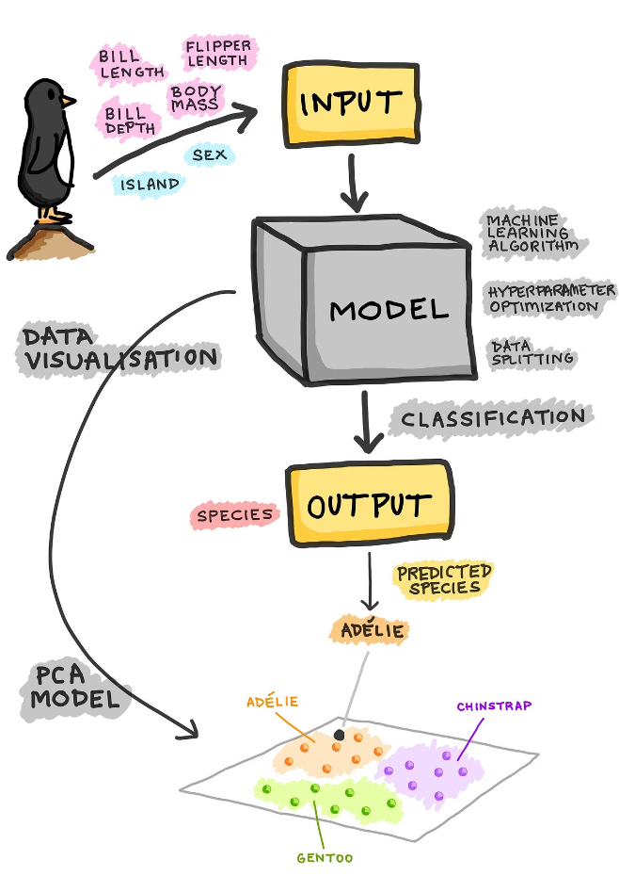
Model Building
and
Evaluation
15

Slide 16




Steps
Model Building
Various machine learning models, such as Logistic Regression, Decision Trees, Random Forest, XGBoost, LightGBM and MLP (Neural Network) was explored and evaluated based on their performance metrics.
Hyperparameter Tuning
Hyperparameters for all the six model s were tuned to optimize its performance, using techniques like grid search /random search and cross-validation = 5.
Evaluation
The model's performance evaluated using appropriate metrics like accuracy, precision, recall, and F1-score. The results compared and analyzed to identify the best-performing model for predicting term deposit subscriptions.
16

Slide 17
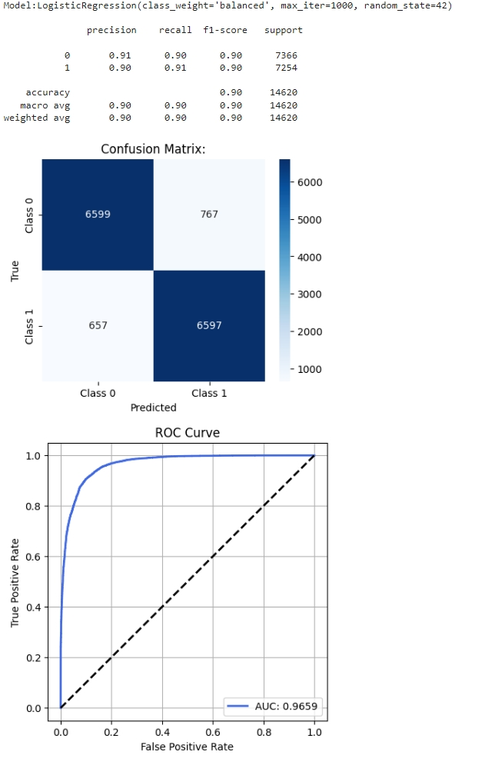
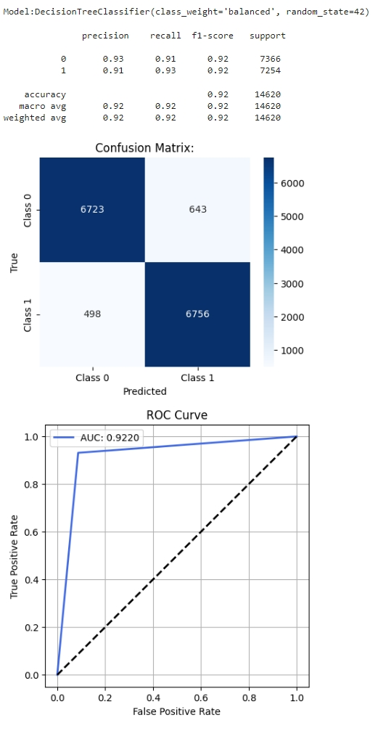
17

Slide 18
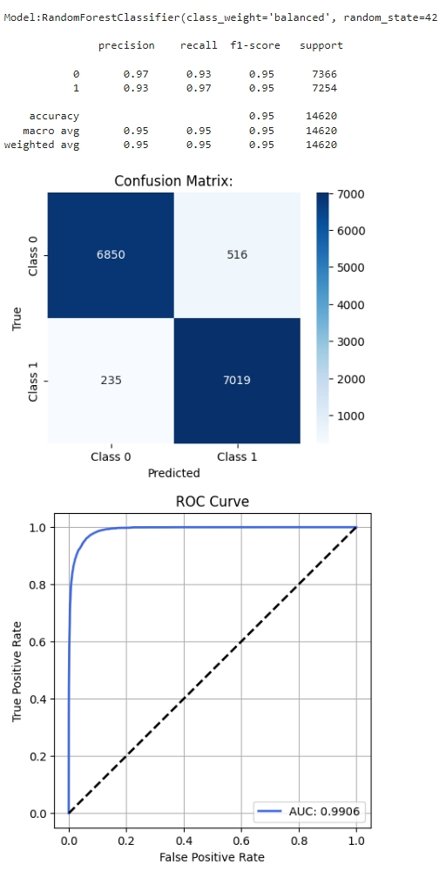
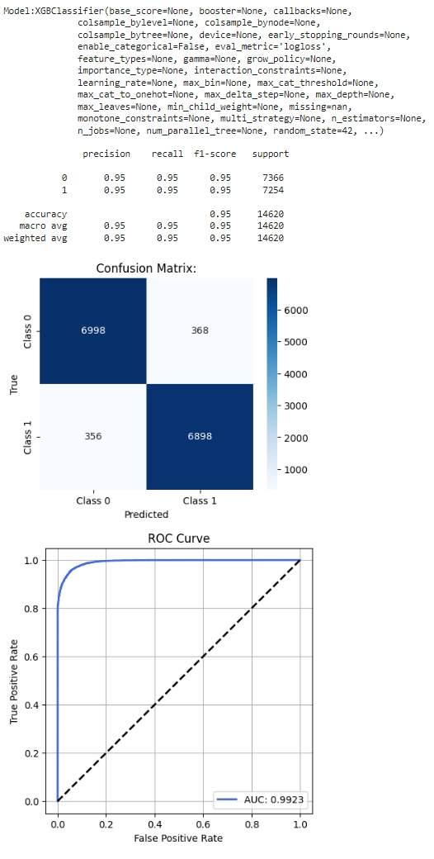
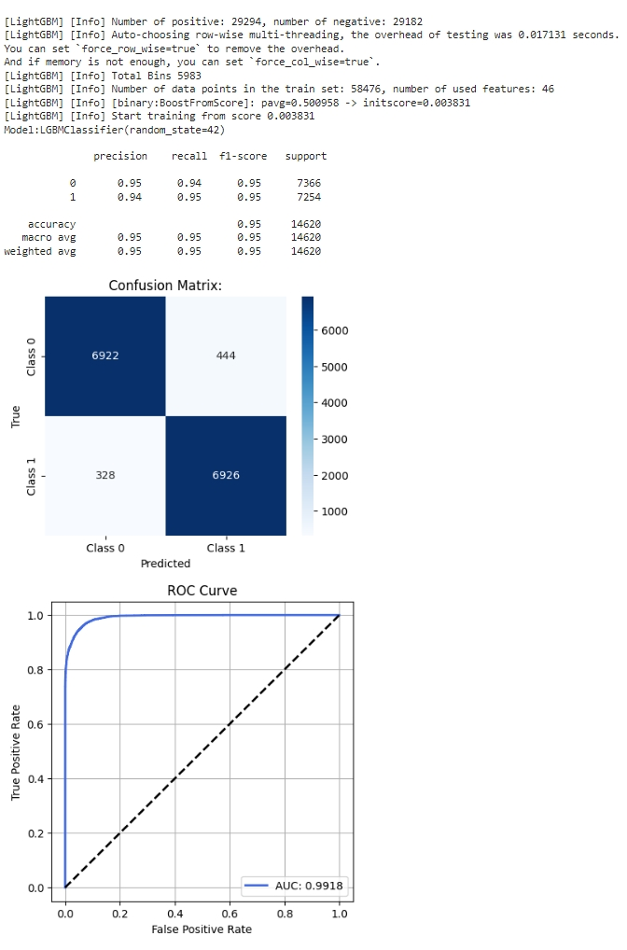
18

Slide 19
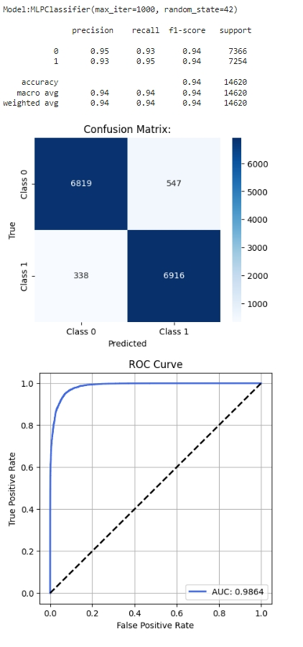
XGBoost, and LightGBM , MLP Classifier(Neural Network) and Random Forest, are the top performers in terms of test accuracy, making them promising candidates for further tuning or deployment.
Decision Tree shows over fitting but still performs decently.
Logistic Regression is a solid baseline model with consistent performance across train and test sets.
19

Slide 20
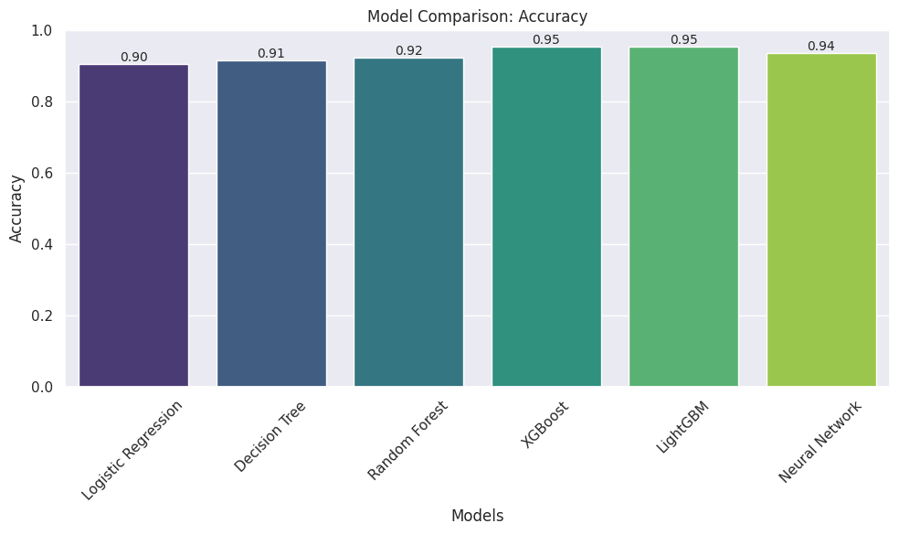
Accuracy metrics using Grid Search technique and cross validation with 5 folds.
20

Slide 21
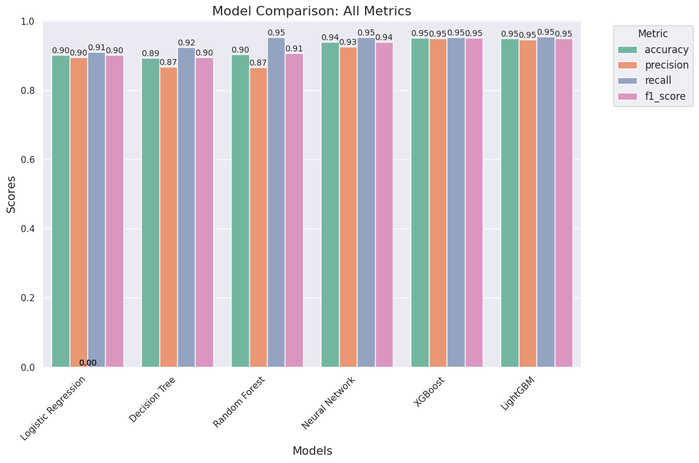
Evaluation using all metrics with Random Search technique and cross validation equal to 5 folds.
21

Slide 22
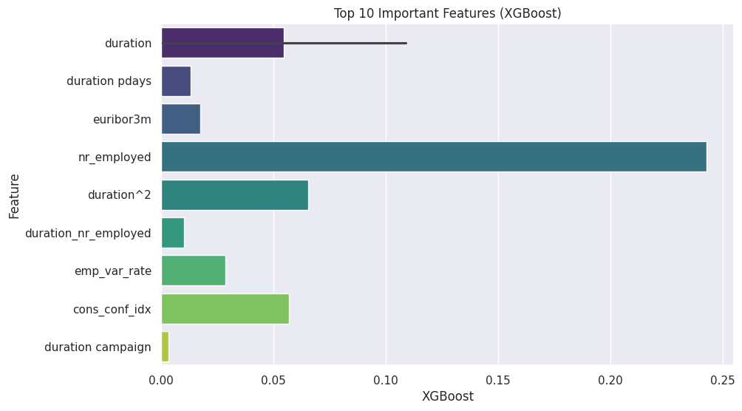
The top 10 important features of the XGBoost model are the key predictors that play a significant role in influencing the model's predictions, as they contribute the most to the decision-making process based on their calculated importance scores.
22

Slide 23

Deployment
23

Slide 24
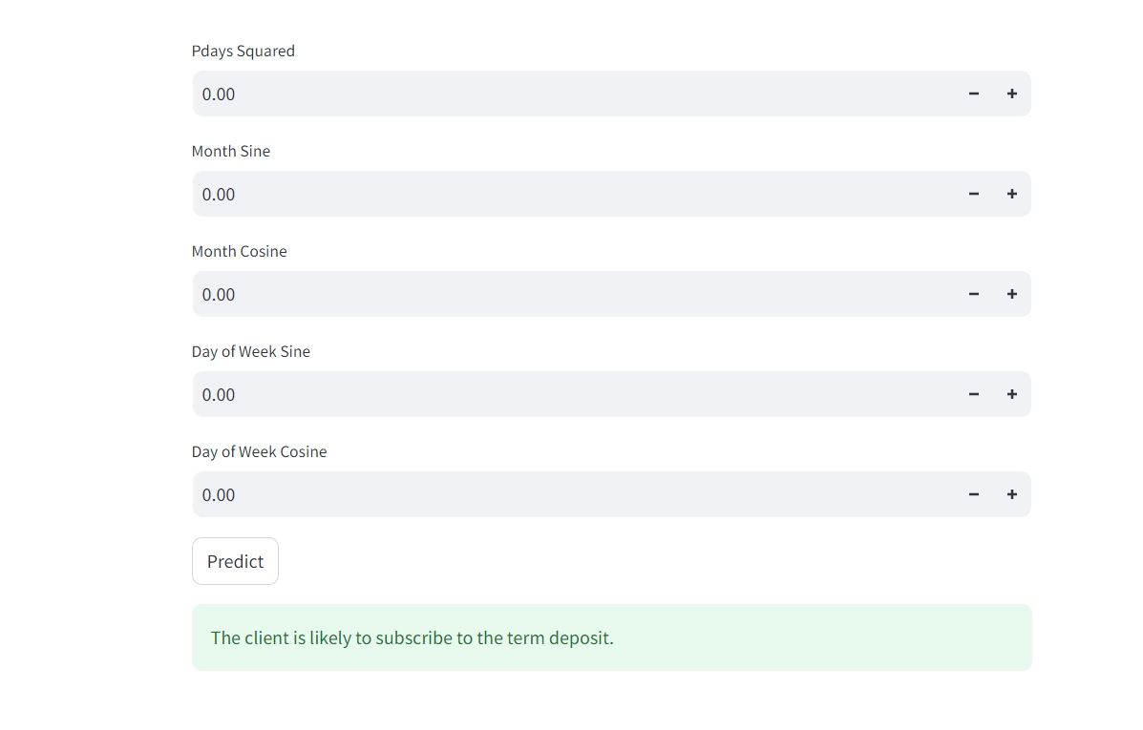
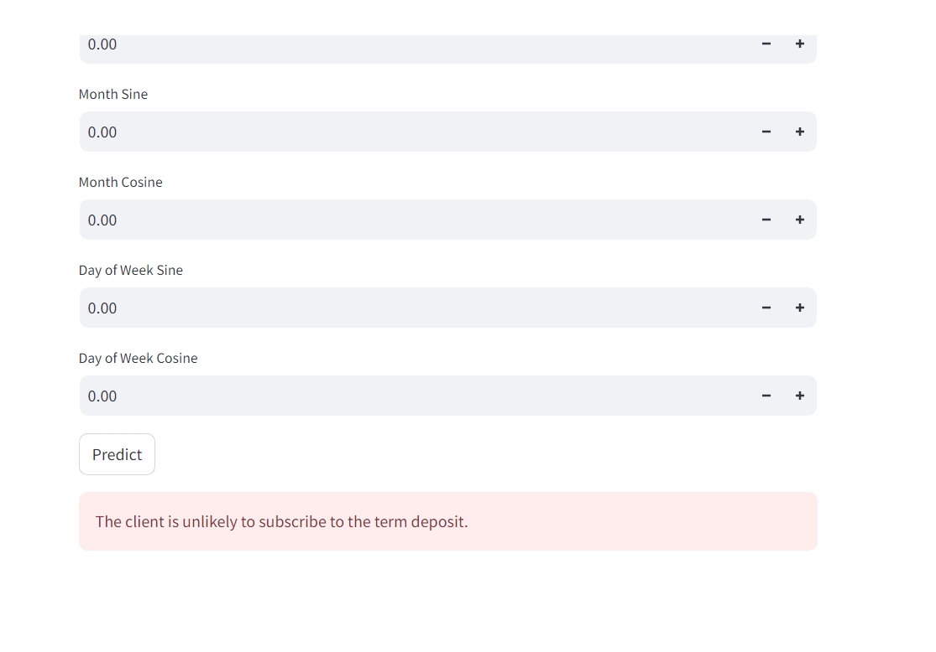
Screenshots
The XGBoost model has been deployed using all 47 features from the training dataset in a real-time prediction system through the Streamlit framework, enabling interactive predictions.
24

Slide 25
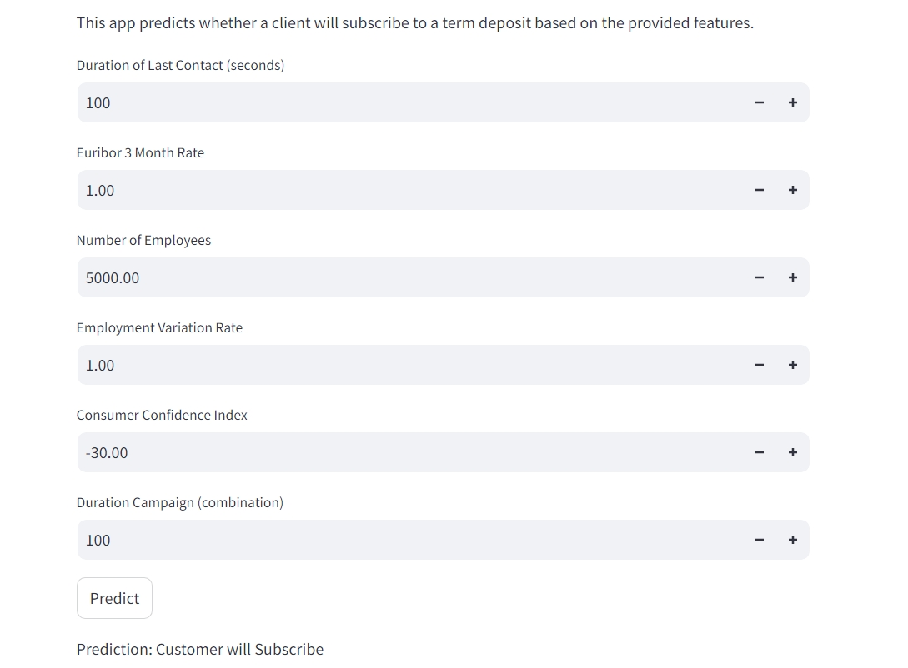
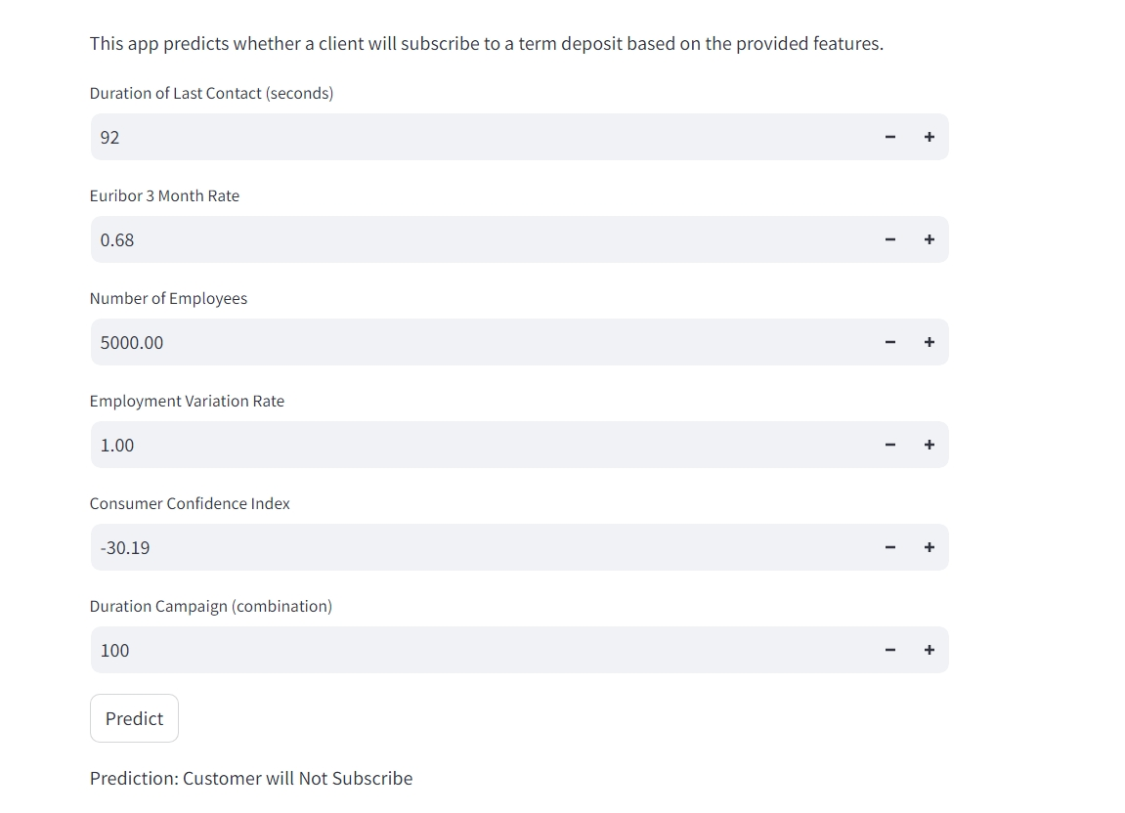
The XGBoost model has been successfully deployed in a real-time prediction system using the top 10 important features identified during the interpretation step.
25

Slide 26
Conclusion
Key Takeaways
The XGBoost model developed provides an effective tool for predicting whether a client will subscribe to a term deposit based on a range of features.
Duration of the client interaction emerged as the most significant predictor, indicating that longer calls often correlate with successful subscription.
Economic indicators such as euribor3m (interest rates) and nr_employed (employment levels) were also important in determining the likelihood of subscription.
Deployment
The model has been deployed through a real-time prediction system using the Streamlit framework.
26

Slide 27





Project Outcome & Impact
Increased Term Deposit Subscriptions
Drive growth in term deposit subscriptions.
Enhanced Customer Retention
Improve customer satisfaction and loyalty.
Data-Driven Marketing Strategies
Optimize marketing campaigns for maximum effectiveness.
Team Collaboration
27
10

Slide 28

Thank You
28

